Slide 1
Variation Cytoscape 3 app
Michael L Heuer
dishevelled.org
28 Oct 2013

Slide 2
Hacking variation-cytoscape3-app
Install
Subversion, http://subversion.apache.org
JDK 1.7 or later, http://openjdk.java.net
Apache Maven 3.1.0 or later, http://maven.apache.org
Checkout dishevelled.org
$ svn co https://svn.code.sf.net/p/dishevelled/code/trunk dishevelled-trunk
Install the entire lot (will take a few minutes)
$ cd dishevelled-trunk
$ mvn install
Package variation-cytoscape3-app
$ cd variation-cytoscape3-app
$ mvn package
Load target/dsh-variation-cytoscape3-app-1.0-SNAPSHOT.jar in Cytoscape 3.x
Apps → App Manager → Install from File...

Slide 3
Using variation-cytoscape3-app
Download snapshot release
http://tinyurl.com/qj8e6m5
or
https://dl.dropboxusercontent.com/u/87680069/dsh-variation-cytoscape3-app-1.0-SNAPSHOT.jar
Video walkthrough
http://youtu.be/FIjW0pgL5OY

Slide 4


Availability
The Variation app for Cytoscape 3 is Free/Libre and Open Source software.
Licensed GNU Lesser General Public License (LGPL), version 3 or later.
Source in subversion repository at
https://svn.code.sf.net/p/dishevelled/code/trunk/variation-cytoscape3-app
Developer home page at
http://www.dishevelled.org/variation-cytoscape3-app
Will be available on the Cytoscape 3 App Store in Q1 2014 at
http://apps.cytoscape.org/apps/variation

Slide 5

Retrieve features task
Given a network with nodes annotated with Ensembl gene ids
Apps → Variation
On Config tab set Ensembl gene id column: field to correct node table column
On Config tab set Feature service: combo box to desired implementation
Click the Apply button if any configuration data changes
Click Retrieve features... tool bar button
All genomic features associated with the nodes in the current network are displayed in the Feature view

Slide 6

Add variations task
Given a network with nodes annotated with Ensembl gene ids
Apps → Variation
On Config tab set Ensembl gene id column: field to correct node table column
On Config tab set Feature service: combo box to desired implementation
On Config tab set Variation service: combo box to desired implementation
Click the Apply button if any configuration data changes
Click Add variations... tool bar button
All genomic features associated with the nodes in the current network are displayed in the Feature view
All variations associated with the genomic features associated with the nodes in the current network are displayed in the Variation view
A new column ‘variation_count’ is added to the node table with the aggregate total count of variations per node

Slide 7

Annotate variation consequences task
Given a network with nodes annotated with Ensembl gene ids
Apps → Variation
On Config tab set Ensembl gene id column: field to correct node table column
On Config tab set Feature service: combo box to desired implementation
On Config tab set Variation service: combo box to desired implementation
On Config tab set Consequence service: combo box to desired implementation
Click the Apply button if any configuration data changes
Click Annotate variation consequences... tool bar button
All genomic features associated with the nodes in the current network are displayed in the Feature view
All variations associated with the genomic features associated with the nodes in the current network are displayed in the Variation view
All variation consequences for all variations associated with the genomic features associated with the nodes in the current network are displayed in the Consequence view
A new column ‘variation_count’ is added to the node table with the aggregate total count of variations per node
A new column ‘variation_consequence_count’ is added to the node table with the aggregate total count of variation consequences per node
New columns for each Sequence Ontology (SO) consequence term (e.g. ‘stop_gained’, ‘stop_lost’) are added to the node table with the aggregate total count of variation consequences per node

Slide 8

Predict variation consequences task
Given a network with nodes annotated with Ensembl gene ids
Apps → Variation
On Config tab set Ensembl gene id column: field to correct node table column
On Config tab set Feature service: combo box to desired implementation
On Config tab set Variation service: combo box to desired implementation
On Config tab set Consequence prediction service: combo box to desired implementation
Click the Apply button if any configuration data changes
Click Annotate variation consequences... tool bar button
All genomic features associated with the nodes in the current network are displayed in the Feature view
All variations associated with the genomic features associated with the nodes in the current network are displayed in the Variation view
All newly predicted variation consequences for all variations associated with the genomic features associated with the nodes in the current network are displayed in the Consequence view
A new column ‘variation_count’ is added to the node table with the aggregate total count of variations per node
A new column ‘variation_consequence_count’ is added to the node table with the aggregate total count of newly predicted variation consequences per node
New columns for each Sequence Ontology (SO) consequence term (e.g. ‘stop_gained’, ‘stop_lost’) are added to the node table with the aggregate total count of newly predicted variation consequences per node

Slide 9
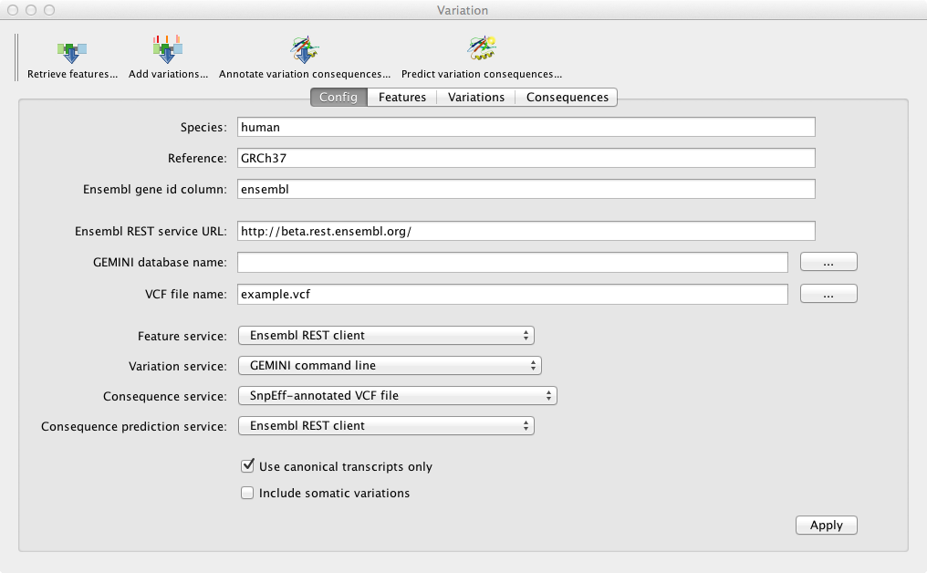

Slide 10
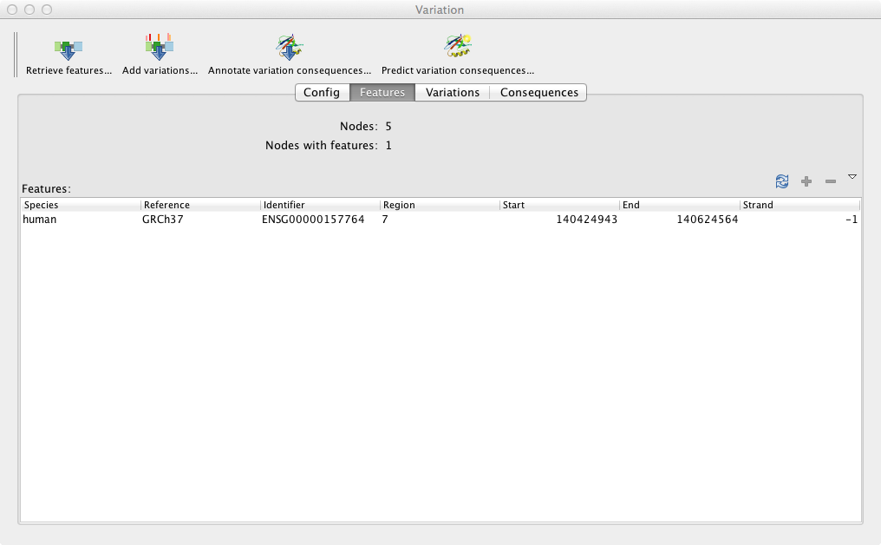

Slide 11
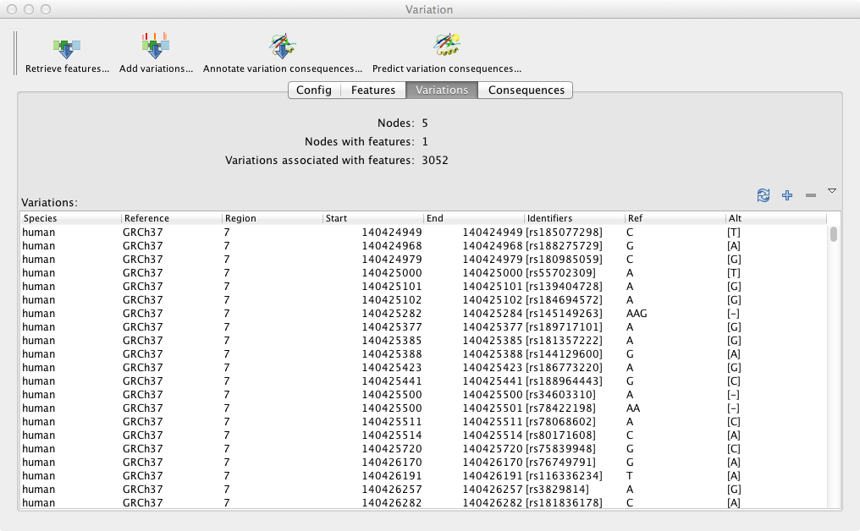

Slide 12
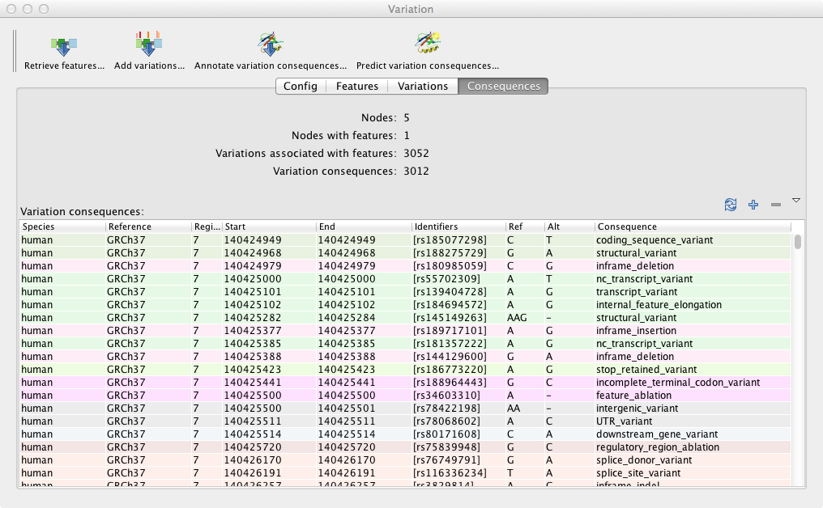

Slide 13
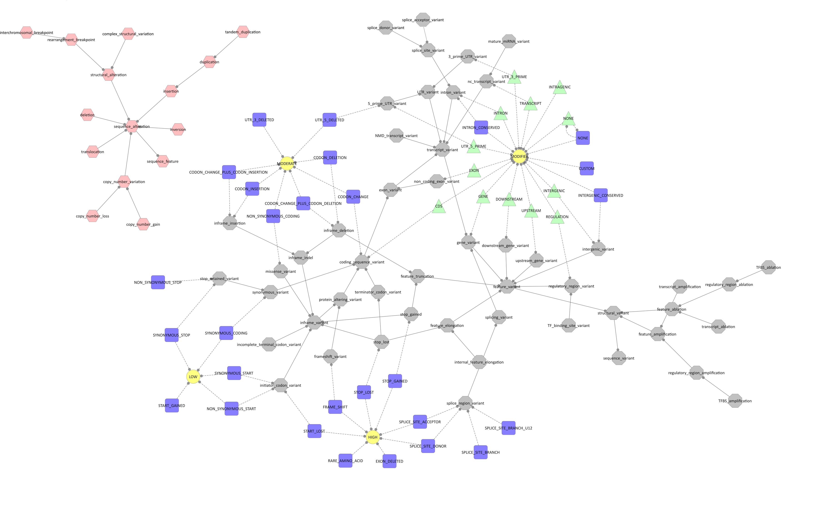
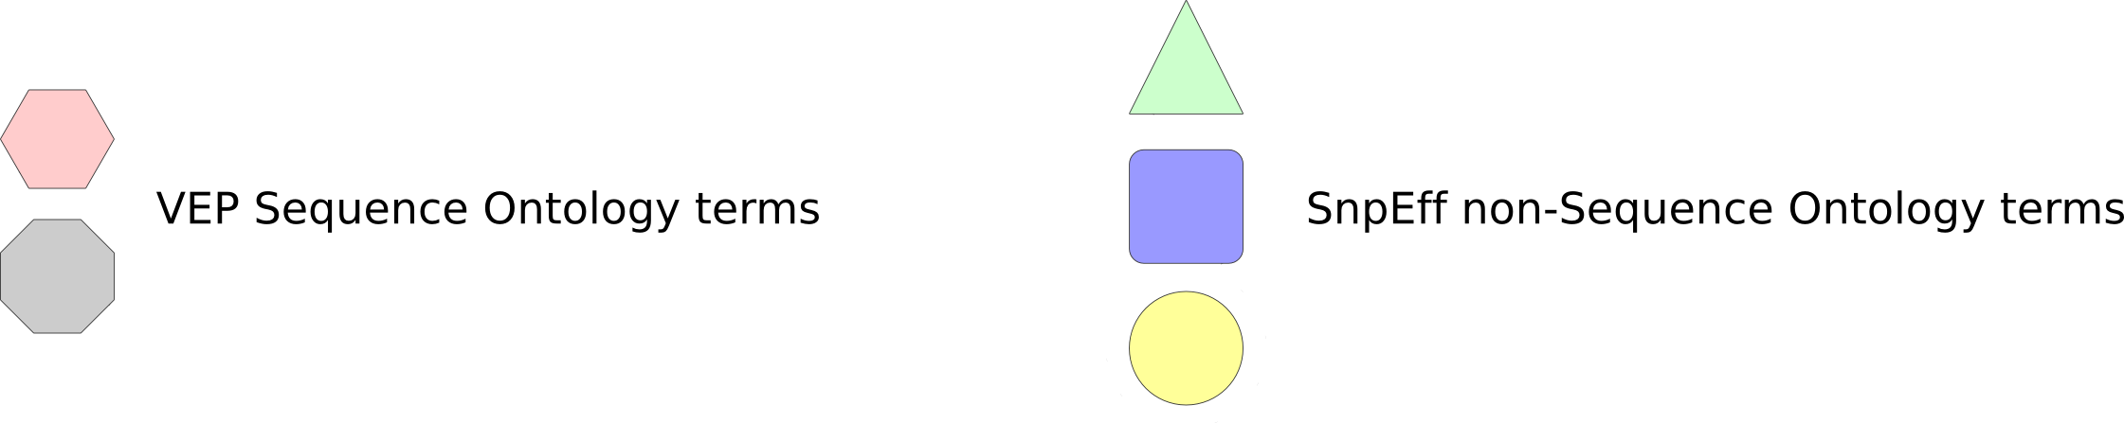
E.g.
https://github.com/arq5x/gemini/issues/207

Slide 14
